Slide 1
Things you should know!
Today’s attendance is a sign-in sheet!
Midterms are next week!

Slide 2

Midterms:
Format
30 minute technical phone interview
1 Behavioral Question
1 Technical Question
Google Docs/Google Hangouts
Sign ups
ter.ps/fen
Once 9 people have signed up for an instructor, all of that instructor’s time slots are closed
Check before you sign up!
Rubric
ter.ps/feo

Slide 3
Week 7!
CMSC389O: The Coding Interview

Slide 4
Today
Trees
Graphs

Slide 5
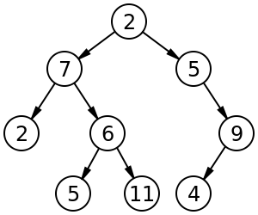
Tree Traversals
Pre-order
2 7 2 6 5 11 5 9 4
In-order
27 5 6 11 2 5 4 9
Post-order
2 5 11 6 7 4 9 5 2

Slide 6
Breadth-First Search
Given a Graph of Nodes, graph, and a starting node, startNode:
Queue<Node> queue = new LinkedList<Node>();
Set<Node> visited = new HashSet<Node>();
queue.add(startNode);
while(!queue.isEmpty()) {
Node node = queue.remove();
process(node);
for (Node n : graph.getNeighbors(node)) {
if ( !visited.contains(n) ) queue.add(n);
}
}

Slide 7
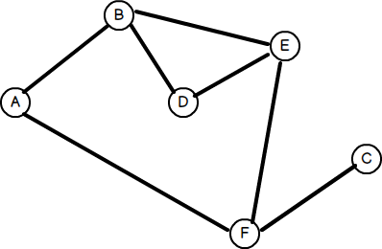
Let’s Run Through An Example!

Slide 8
Depth-First Search
Given a Graph of Nodes, graph, and a starting node, startNode:
Stack<Node> stack = new Stack<Node>();
Set<Node> visited = new HashSet<Node>();
stack.push(startNode);
while(!stack.isEmpty()) {
Node node = stack.pop();
process(node);
for (Node n : graph.getNeighbors(node)) {
if ( !visited.contains(n) ) stack.push(n);
}
}

Slide 9
Let’s Run Through An Example!

Slide 10
When is DFS and BFS useful?
Can be useful when you need to search within a tree or graph
TIP: exploit the process(node) part of DFS/BFS

Slide 11
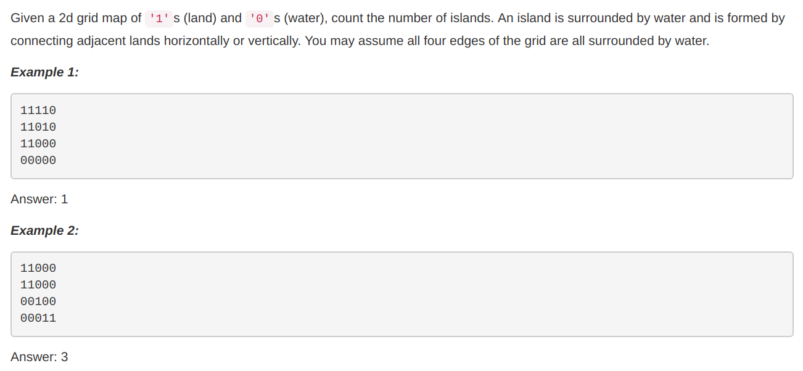
Example 1

Slide 12
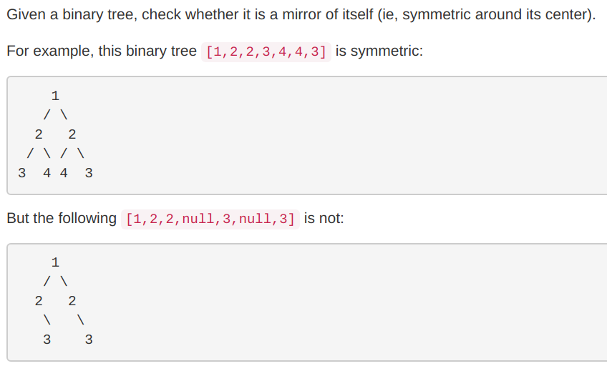

Slide 13
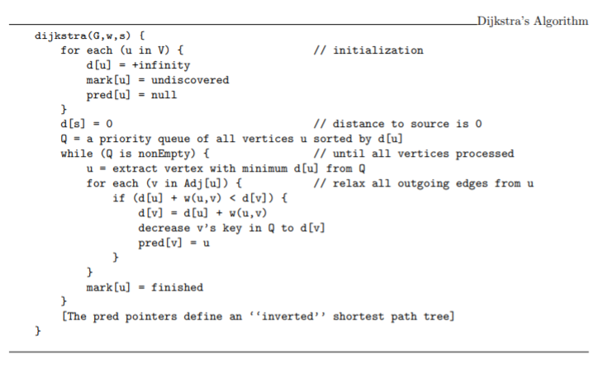
Dijkstra's Algorithm

Slide 14
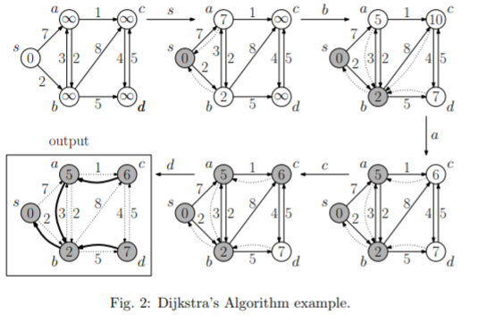
Dijkstra's Algorithm

Slide 15
Heaps
PriorityQueue<Integer> PQ = new PriorityQueue<Integer>(1000, new Comparator<Integer>() { public int compare(Integer num1, Integer num2) { If (num1 > num2) return 1; else if (num1 < num2) return -1; return 0; } });
If you choose to use Python… good for you. (import minheap) C on the other hand...

Slide 16
Dictionaries:
Problem: You have a set of words and need to determine if a word is within your set.
What data structure should you use to store your dictionary?
What is the time/space complexity for
Adding a word
Deleting a word
Searching for a word
Space complexity for your dictionary as a whole

Slide 17
Tries!
Ordered tree data structure that is used to store a dynamic sector associative array where the keys are usually strings
Complexities
O(L) to insert
O(L) to search

Slide 18
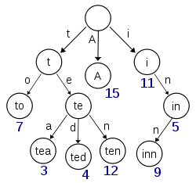
Tries

Slide 19
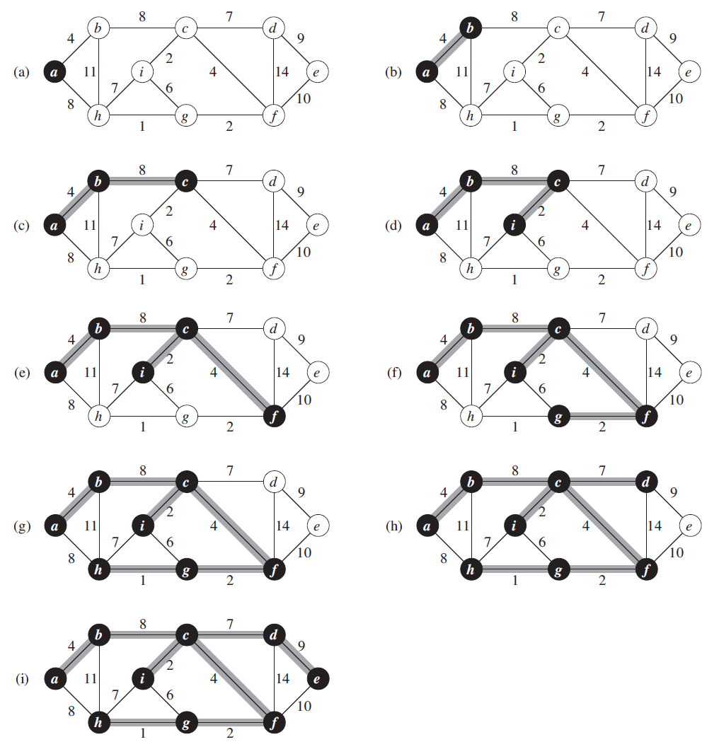
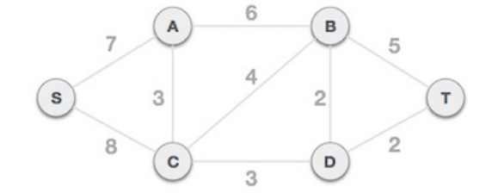
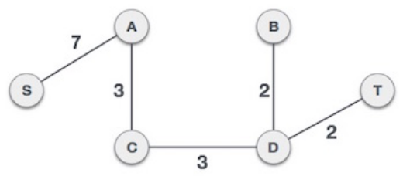
Minimum Spanning Trees
Prim’s Algorithm: start with a randomly selected start node and select the minimum-weight edge touching it. select the next minimum-weight edge until the MST touches all nodes
Kruskal’s Algorithm: select the next minimum-weight edge that does not cause a circuit until the MST touches all nodes

Slide 20
Serializing and Deserializing
Let’s figure this out together!
What do we mean by Serializing and Deserializing? Storing and restoring a tree in a file or an array.
How can we store this information? Think of traversals. Think of the type of tree it is. Is it a BST? Complete Tree? Full Tree?

Slide 21
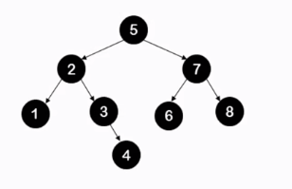
Serializing a BST
Think of Pre-Order Traversal: 5, 2, 1, -1, -1, 3, -1, 4, 7, 6, -1, -1, 8, -1, -1
The ‘-1’s mean that it is a NULL value! (If we are using negatives and positives, pick another character.)
Traverse the list in-order. If it does not have any children, put in a -1 as the base case. This creates the list as above.

Slide 22
Deserialize a BST
Keep recursively building the tree to the left until you get to a ‘-1’ value. Then, it undoes itself in its recursion, and goes to the right, doing the same building step as before.
This keeps going no matter what, since the tree building is independent of the other branches.

Slide 23
Reminders
Fill out feedback form at ter.ps/ffe !
Send us your photos from the career fair for extra credit!

